Slide 1
Kubernetes Core Concepts: Deployment Rollouts, Labels and Selectors, Services
Week 6

Slide 2
Agenda
Rollouts
Services
Deployments

Slide 3

Deployment Rollouts
Rollout is a process or creating or upgrading application containers
Rollout happens when
We create a new deployment
Update images used in the existing deployment
Rollout creates a new deployment revision
Revisions help in keeping history and enable rollback

Slide 4
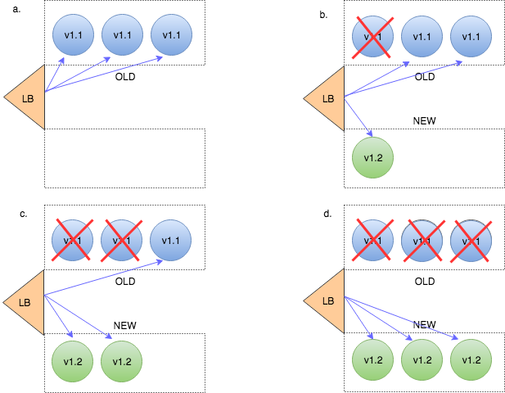
Rollout Strategies: Rollout
Default strategy
No downtime

Slide 5
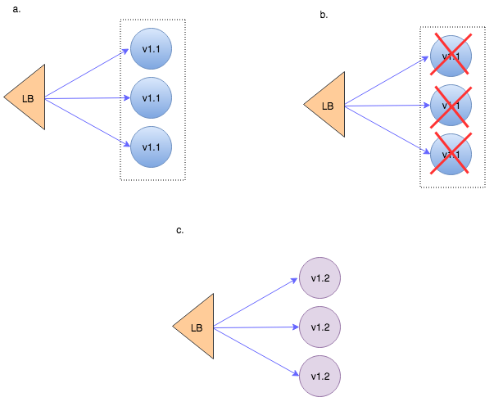
Rollout Strategies: Recreate
Application downtime
Should be specified explicitly

Slide 6

Workshop 1 – Deployment Rollouts, Revisions and Rollbacks

Slide 7
Working with deployment
# Copy deployment file to the machine runnign kind K8s cluster
scp -i week6 week6Session1/deployment.yaml 44.201.36.90:/tmp
# Log into EC2, start docker daemon on EC2
sudo systemctl start docker
# Create new namespace and create and nginx deployment
k create ns nginx
k apply –f /tmp/deployment.yaml
# Lets see the status of our deployment
k rollout status deployment.apps/deployment-nginx -n nginx
k get all –n nginx
# Why is there only one rollout?
k rollout history deployment.apps/deployment-nginx -n nginx

Slide 8
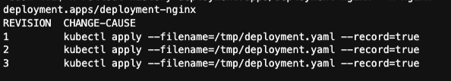
Creating Revisions
# Re-create the deployment and record change history
k apply -f /tmp/deployment.yaml --record
k rollout history deployment.apps/deployment-nginx -n nginx
# Change nginx image version in the YAML
k apply -f /tmp/deployment.yaml --record
K get pods –n nginx
# Change again with "kubectl edit"
k edit deployment.apps/deployment-nginx -n nginx
k rollout status deployment.apps/deployment-nginx -n nginx

Slide 9
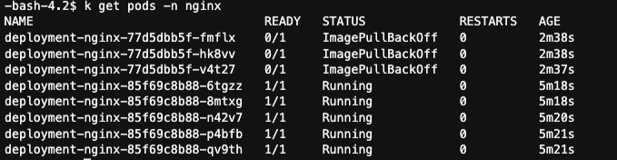
Rollback
# Rollback one revision
k rollout undo deployment.apps/deployment-nginx -n nginx
k rollout history deployment.apps/deployment-nginx -n nginx
# Update deployment manifest to point to non-existent version on nginx
k edit deployment.apps/deployment-nginx -n nginx
# Are the pods replaced with a new version?
k get deployment.apps/deployment-nginx -n nginx
# Are the previous pods terminated?
k get pods –n nginx
# Let's roll back the unsuccessful deployment
k rollout undo deployment.apps/deployment-nginx -n nginx
k get pods -n nginx

Slide 10
Workshop 1 – The End

Slide 11
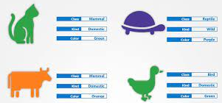
Workshop 2 – Using Labels to Organize K8s Pods

Slide 12

Assigning Labels to Pods
$ kubectl create -f kubia-manual-with-labels.yaml
$ kubectl get po --show-labels
$ kubectl get po -L creation_method,env
$ kubectl label po kubia-manual creation_method=manual
$ kubectl label po kubia-manual-v2 env=debug --overwrite
$ kubectl get po -L creation_method,env

Slide 13

Using Labels
$ kubectl get po -l creation_method=manual
$ kubectl get po -l env
$ kubectl get po -l '!env'

Slide 14
Workshop 2 – The End

Slide 15
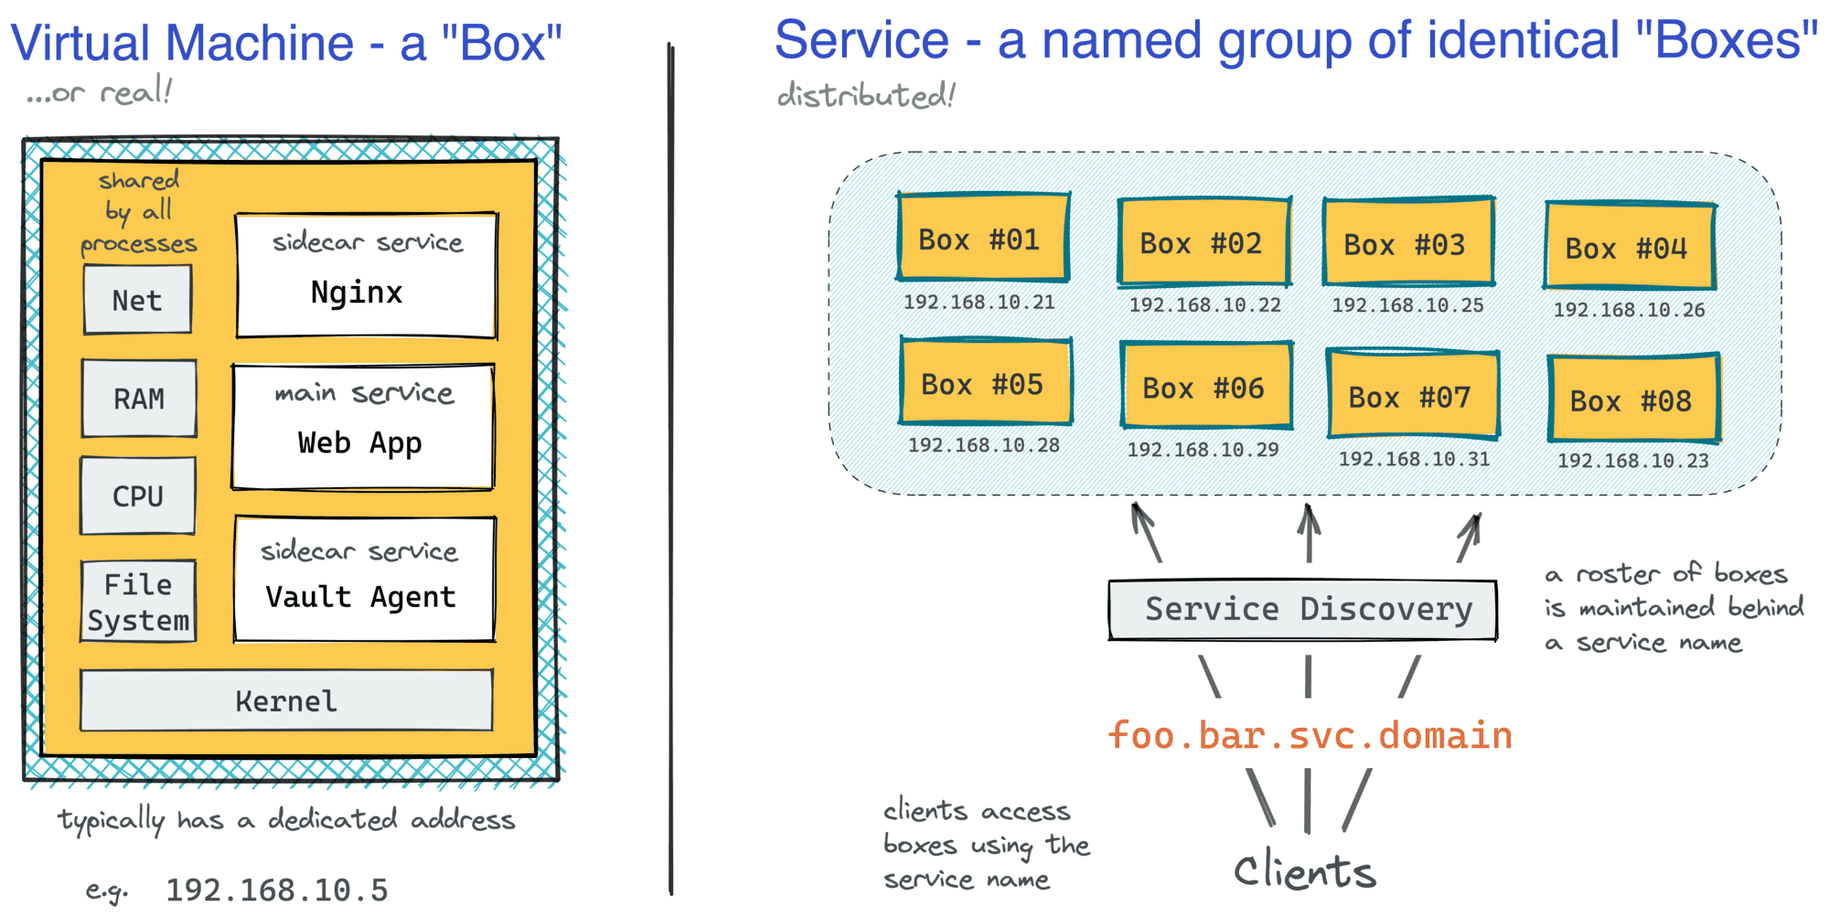
Services in the Traditional Environment
Notes:
https://iximiuz.com/en/posts/kubernetes-vs-virtual-machines/
https://iximiuz.com/en/posts/service-discovery-in-kubernetes/

Slide 16
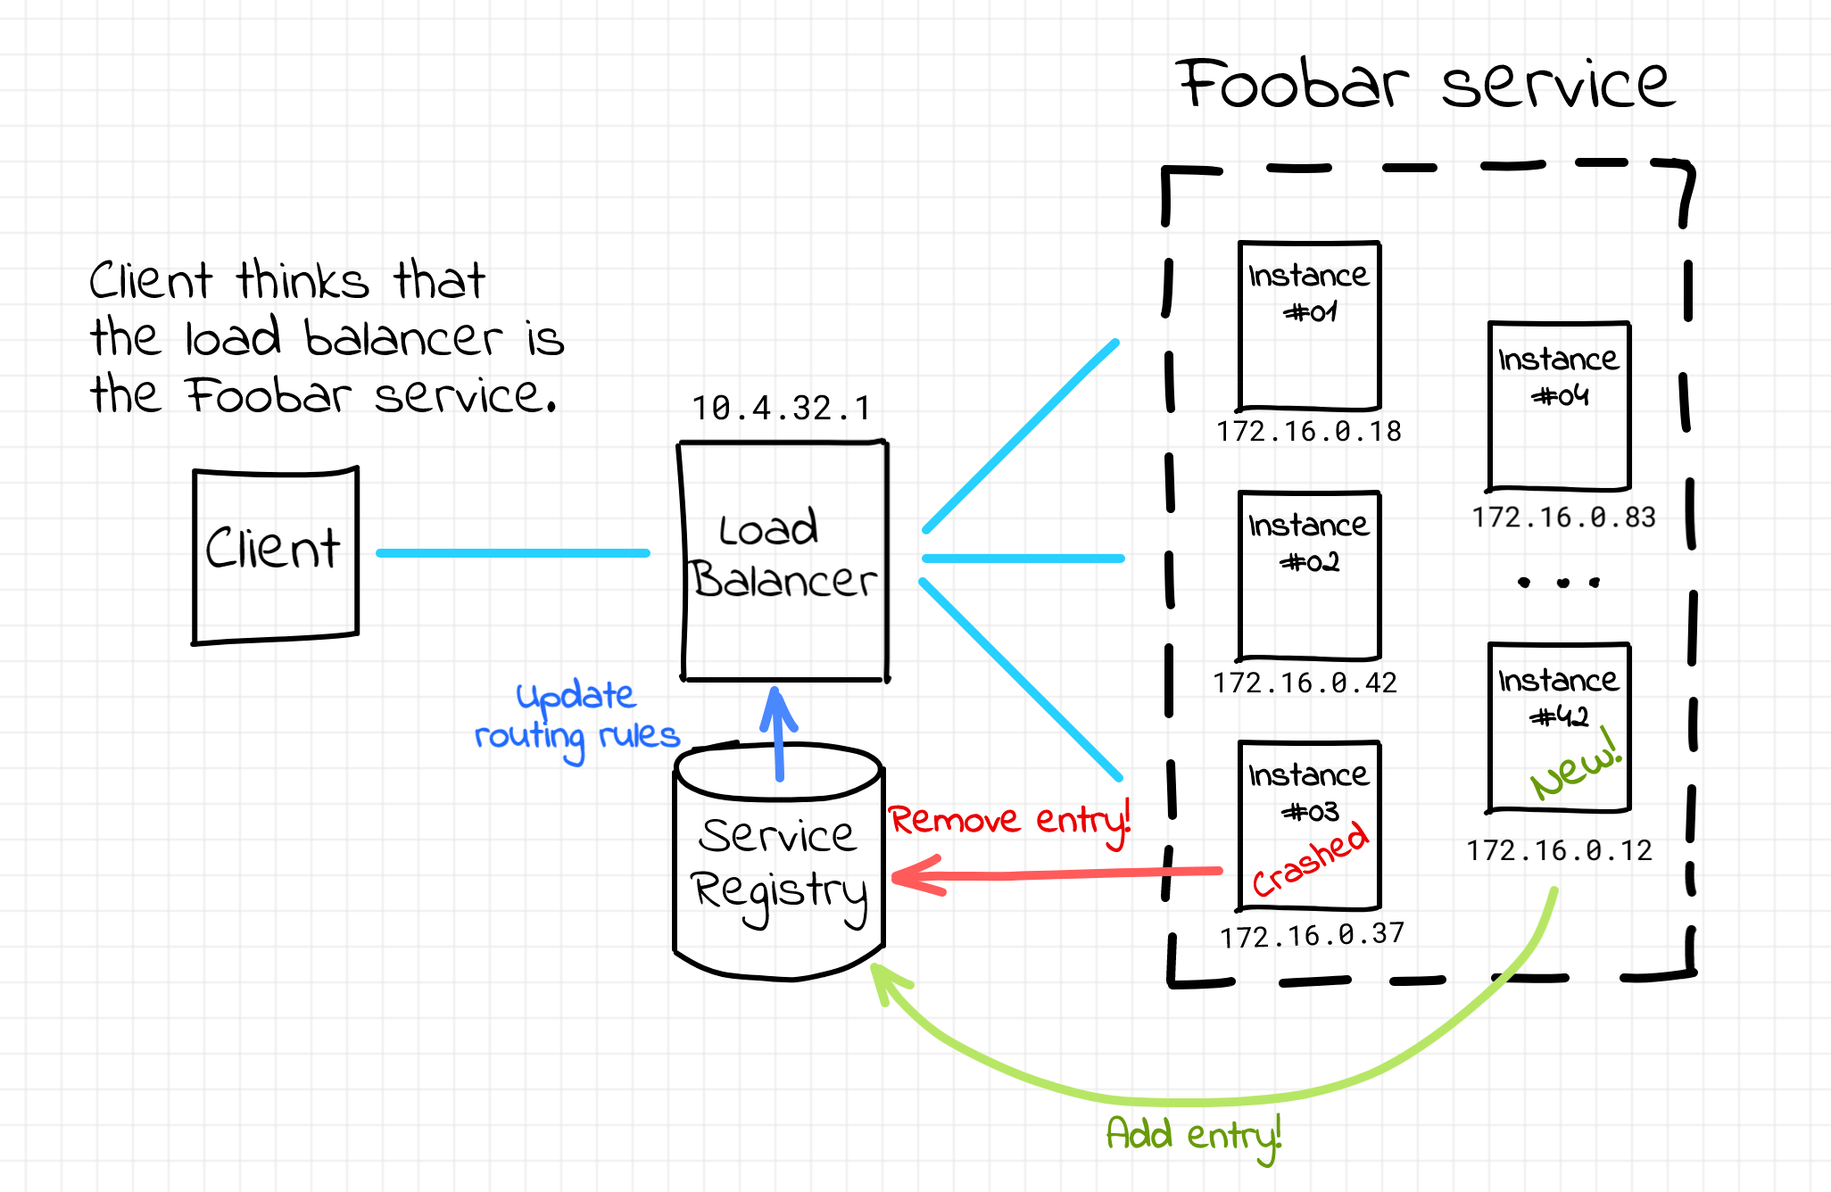
Traditional Service Discovery – Server-Side

Slide 17
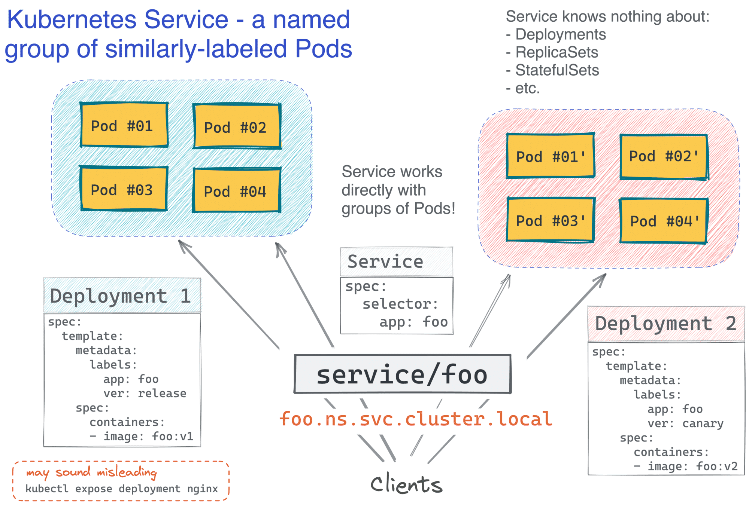
K8s Service - Similarly Labeled Pods
Notes:
https://arthurchiao.art/blog/cracking-k8s-node-proxy/

Slide 18

Exposing containers
Imagine standard client-server configuration. How would we configure the access points for the clients?
Challenges:
We cannot configure pod's IP – pods are ephemeral
Clients do not know server IP upfront
Multiple pods can provide the same service – clients have no way to know
We need a single IP endpoint

Slide 19

Exposing Containers in Kubernetes
We can connect to our pods using their IP address
Then we need to figure out a lot of things:
how do we look up the IP address of the pod(s)?
how do we connect from outside the cluster?
how do we load balance traffic?
what if a pod fails?
Kubernetes has a resource type named Service
Services address all these questions!

Slide 20
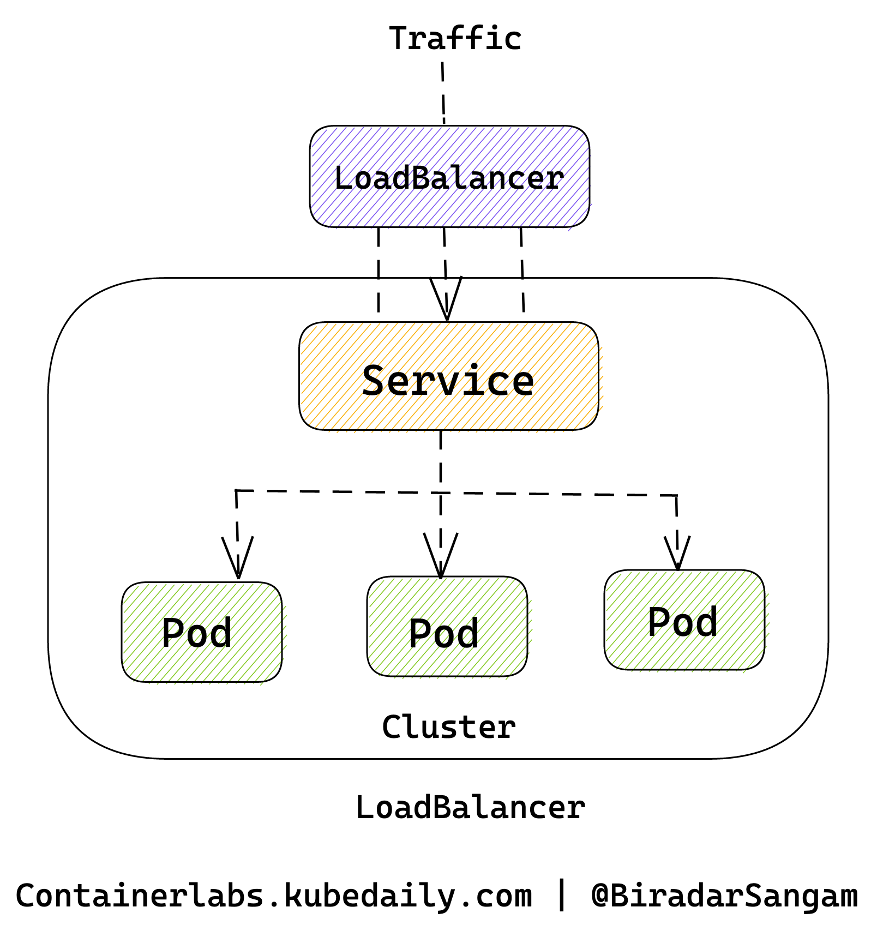
Introducing Kubernetes Services
Immutable point of entry to a group of pods providing the same service
Clients open connections to this IP/port and client's requests are routed to pod backing the service
Services are automatically added to an internal DNS zone

Slide 21
Why Services?
We don't need to look up the IP address of the pod(s)
There are multiple service types; some of them allow external traffic
(e.g. LoadBalancer and NodePort)
Services provide load balancing
Service addresses are independent from pods' addresses

Slide 22
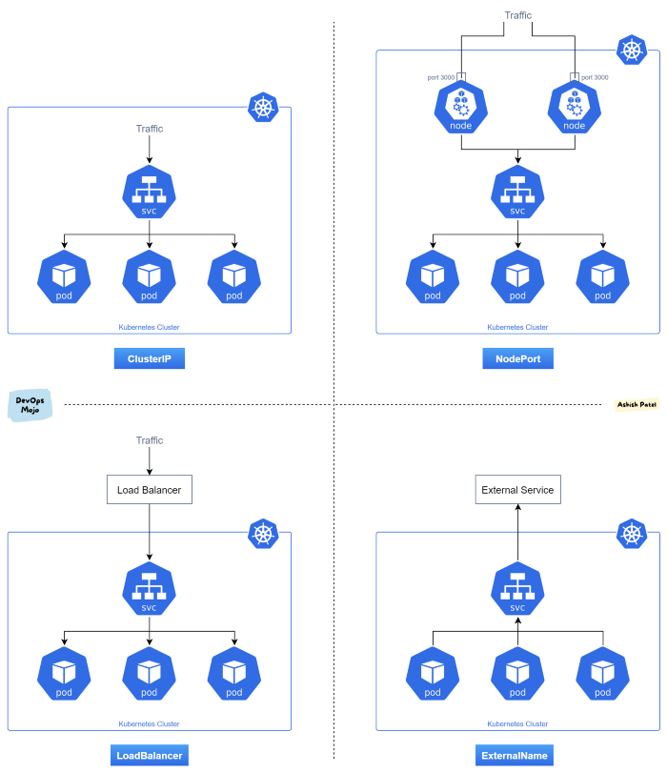
Types of Services
There are different types of services:
ClusterIP, NodePort, LoadBalancer, ExternalName
There are also headless services
Services can also have optional external IPs
There is also another resource type called Ingress
(specifically for HTTP services)

Slide 23
Creating Service Imperatively
# Create a deployment with single replica
kubectl create deploy nginx-deployment --image=nginx
# Scale the deployment to 3 replicas
kubectl scale deploy nginx-deployment --replicas=3 deployment
# Expose the container on port 80
kubectl expose deployment nginx-deployment --port=80
Notes:
https://sunnykkc13.medium.com/deep-dive-into-kubernetes-238258c9a536
What happened behind the scene?
User declares what he/she wants(image 1)and pass that to K8S using kubectl command. We all know that API-Server is the only component that can talk to user, master node other components and worker nodes.
kubectl interacts with API-Server and generates a manifest(we can say a description of user wants).
This manifest is written in ETCD(key-value database and single source of truth) by API-Server.
API-Server got a deployment of nginx so it stores a deployment in ETCD.
As soon as there is something in ETCD, controller manager wakes up and respond according to the requirement. For deployment, a Deployment controller wakes up and check the requirement. It says replica is needed so, it’ll create a replica set(a bunch of item that goes into the pods) and goes to sleep. The ReplicaSet get stored in ETCD and the flow was [controller manager → API-Server → ETCD ].
Now, the controller responsible for replica take its turn and create 3 replicas(Image 4) of pod(just create the pods). The pods details get stored in ETCD.
A ReplicaSet ensures that a specified number of pod replicas are running at any given time. However, a Deployment is a higher-level concept that manages ReplicaSets and provides declarative updates to Pods along with a lot of other useful features(Image 2).
Schedular wakes up and see that there are pending pods without any nodes assigned. So, it will assign the nodes and goes to sleep.
kubelet(on worker node) asks API-Server whether it has something for them? Now nodes has been assigned to pods kubelet will pull the image, networking and response back to API-Server that pods are running and API-Server writes the update to ETCD.
As you can see everything is being written to ETCD from deployment to pods health.
Note: All controller manager’s binaries are compiled in one.

Slide 24
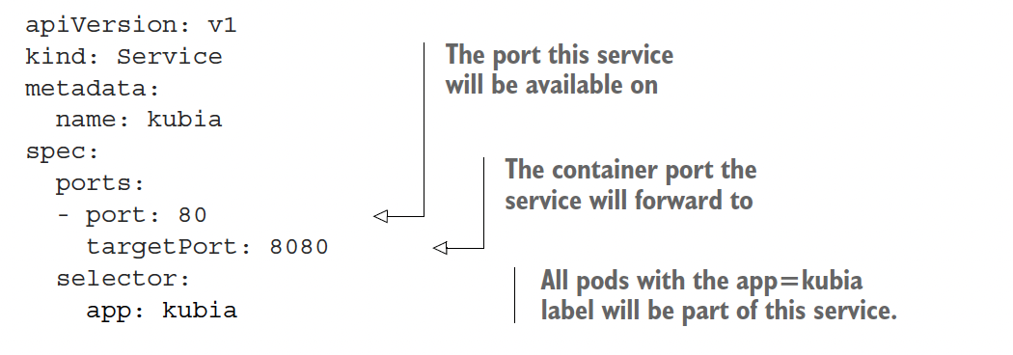
Service Manifest

Slide 25
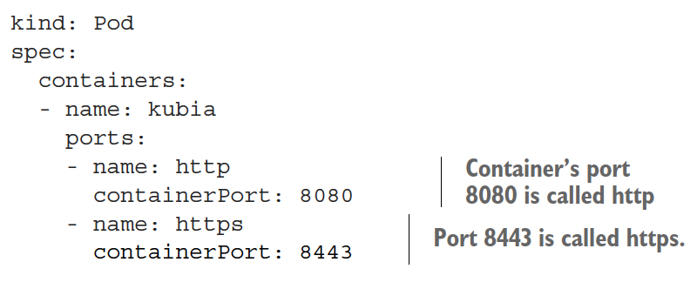
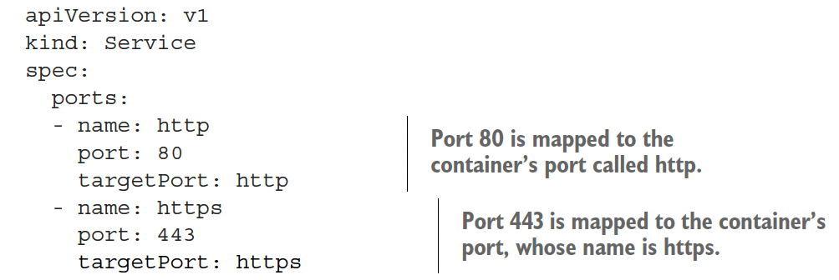
Using Named Ports

Slide 26
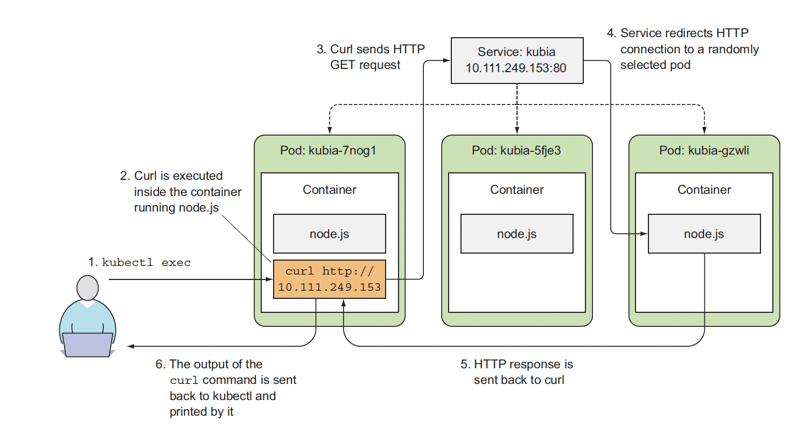
Accessing the Service
Services of type ClusterIP are not externally accessible
We can access this service in different ways
Run a pod in the cluster that will access this service
Execute curl with kubectl exec command
ssh into one of the Kubernetes nodes and use the curl command.

Slide 27
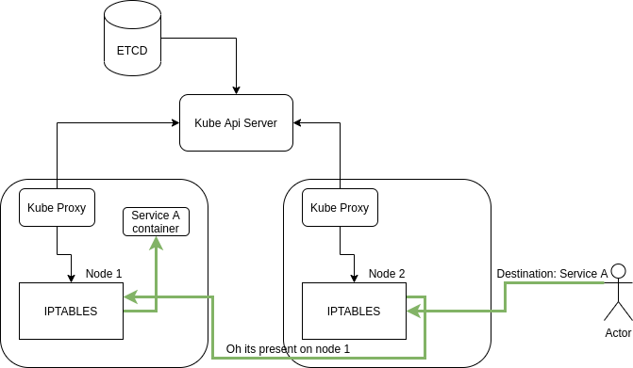
How does it work?
Kube-proxy modifies IPTABLES on each node to create rules for the services we define.
Kube-proxy does not do the actual routing
Notes:
https://medium.com/pixelpoint/kubernetes-port-forwarding-simple-like-never-before-20a8ab16370f

Slide 28
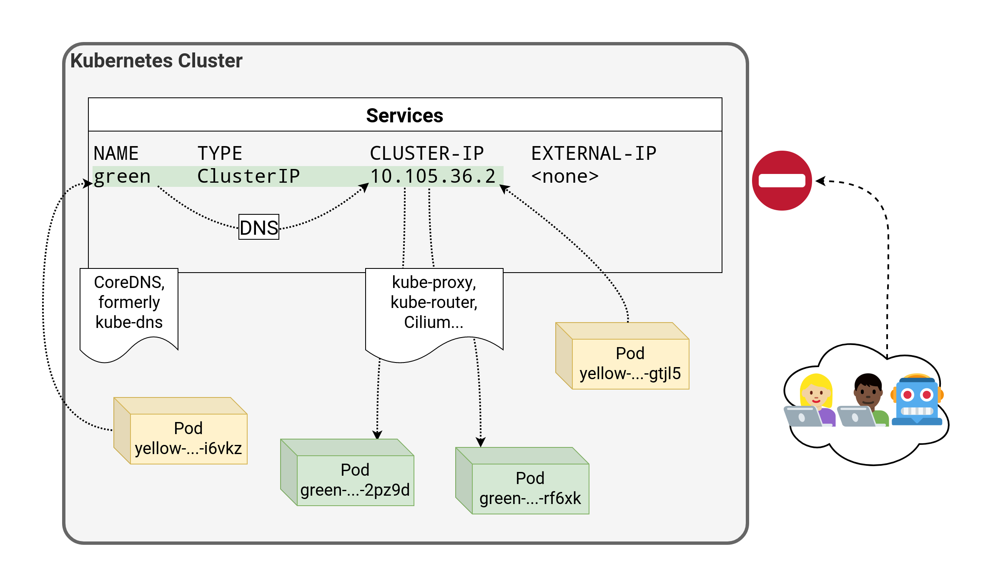
Service Type: ClusterIP
It's the default service type
A virtual IP address is allocated for the service
(in an internal, private range; e.g. 10.96.0.0/12)
This IP address is reachable only from within the cluster (nodes and pods)
Our code can connect to the service using the original port number
Perfect for internal communication, within the cluster

Slide 29
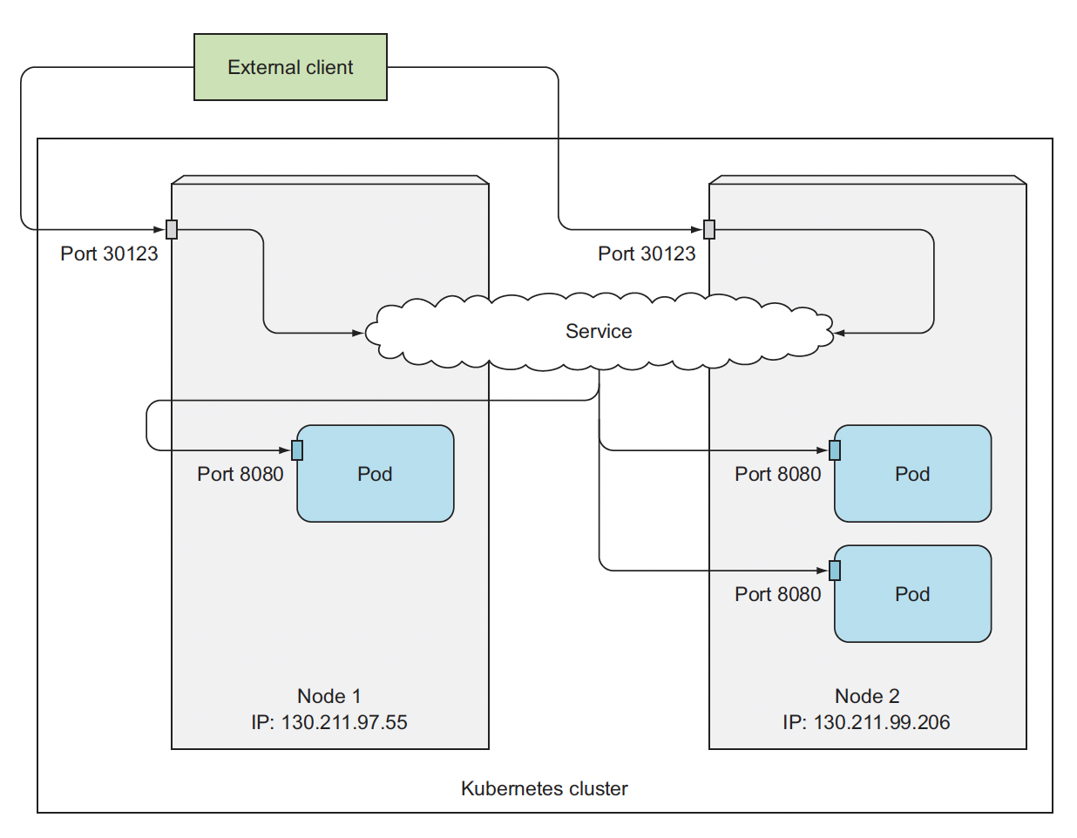
Service Type: NodePort
A port number is allocated for the service
(by default, in the 30000-32767 range)
That port is made available on all our nodes and anybody can connect to it
(we can connect to any node on that port to reach the service)
Our code needs to be changed to connect to that new port number
Under the hood: kube-proxy sets up a bunch of iptables rules on our nodes
Sometimes, it's the only available option for external traffic (e.g. most clusters deployed with kubeadm or on-premises)
Automatically will create a ClusterIP service
Notes:
https://container.training/kube-selfpaced.yml.html#273

Slide 30
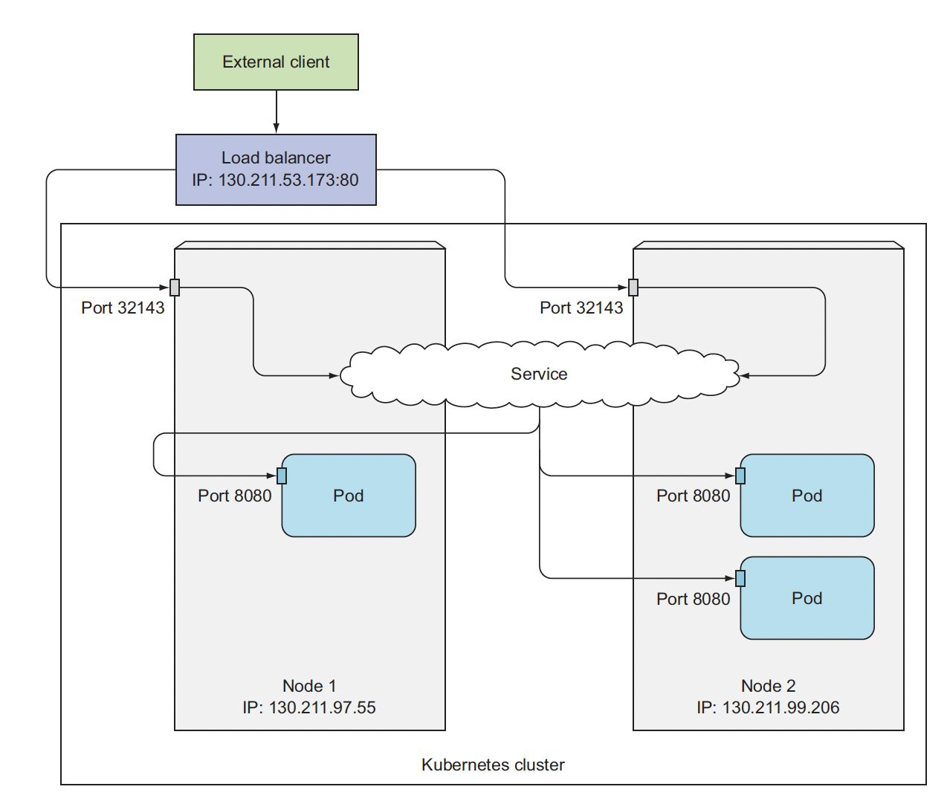
Service Type: LoadBalancer
An external load balancer is allocated for the service
This is available only when the underlying infrastructure provides some kind of "load balancer as a service"
Each service of that type will typically cost a little bit of money
Ideally, traffic would flow directly from the load balancer to the pods
In practice, it will often flow through a NodePort first

Slide 31
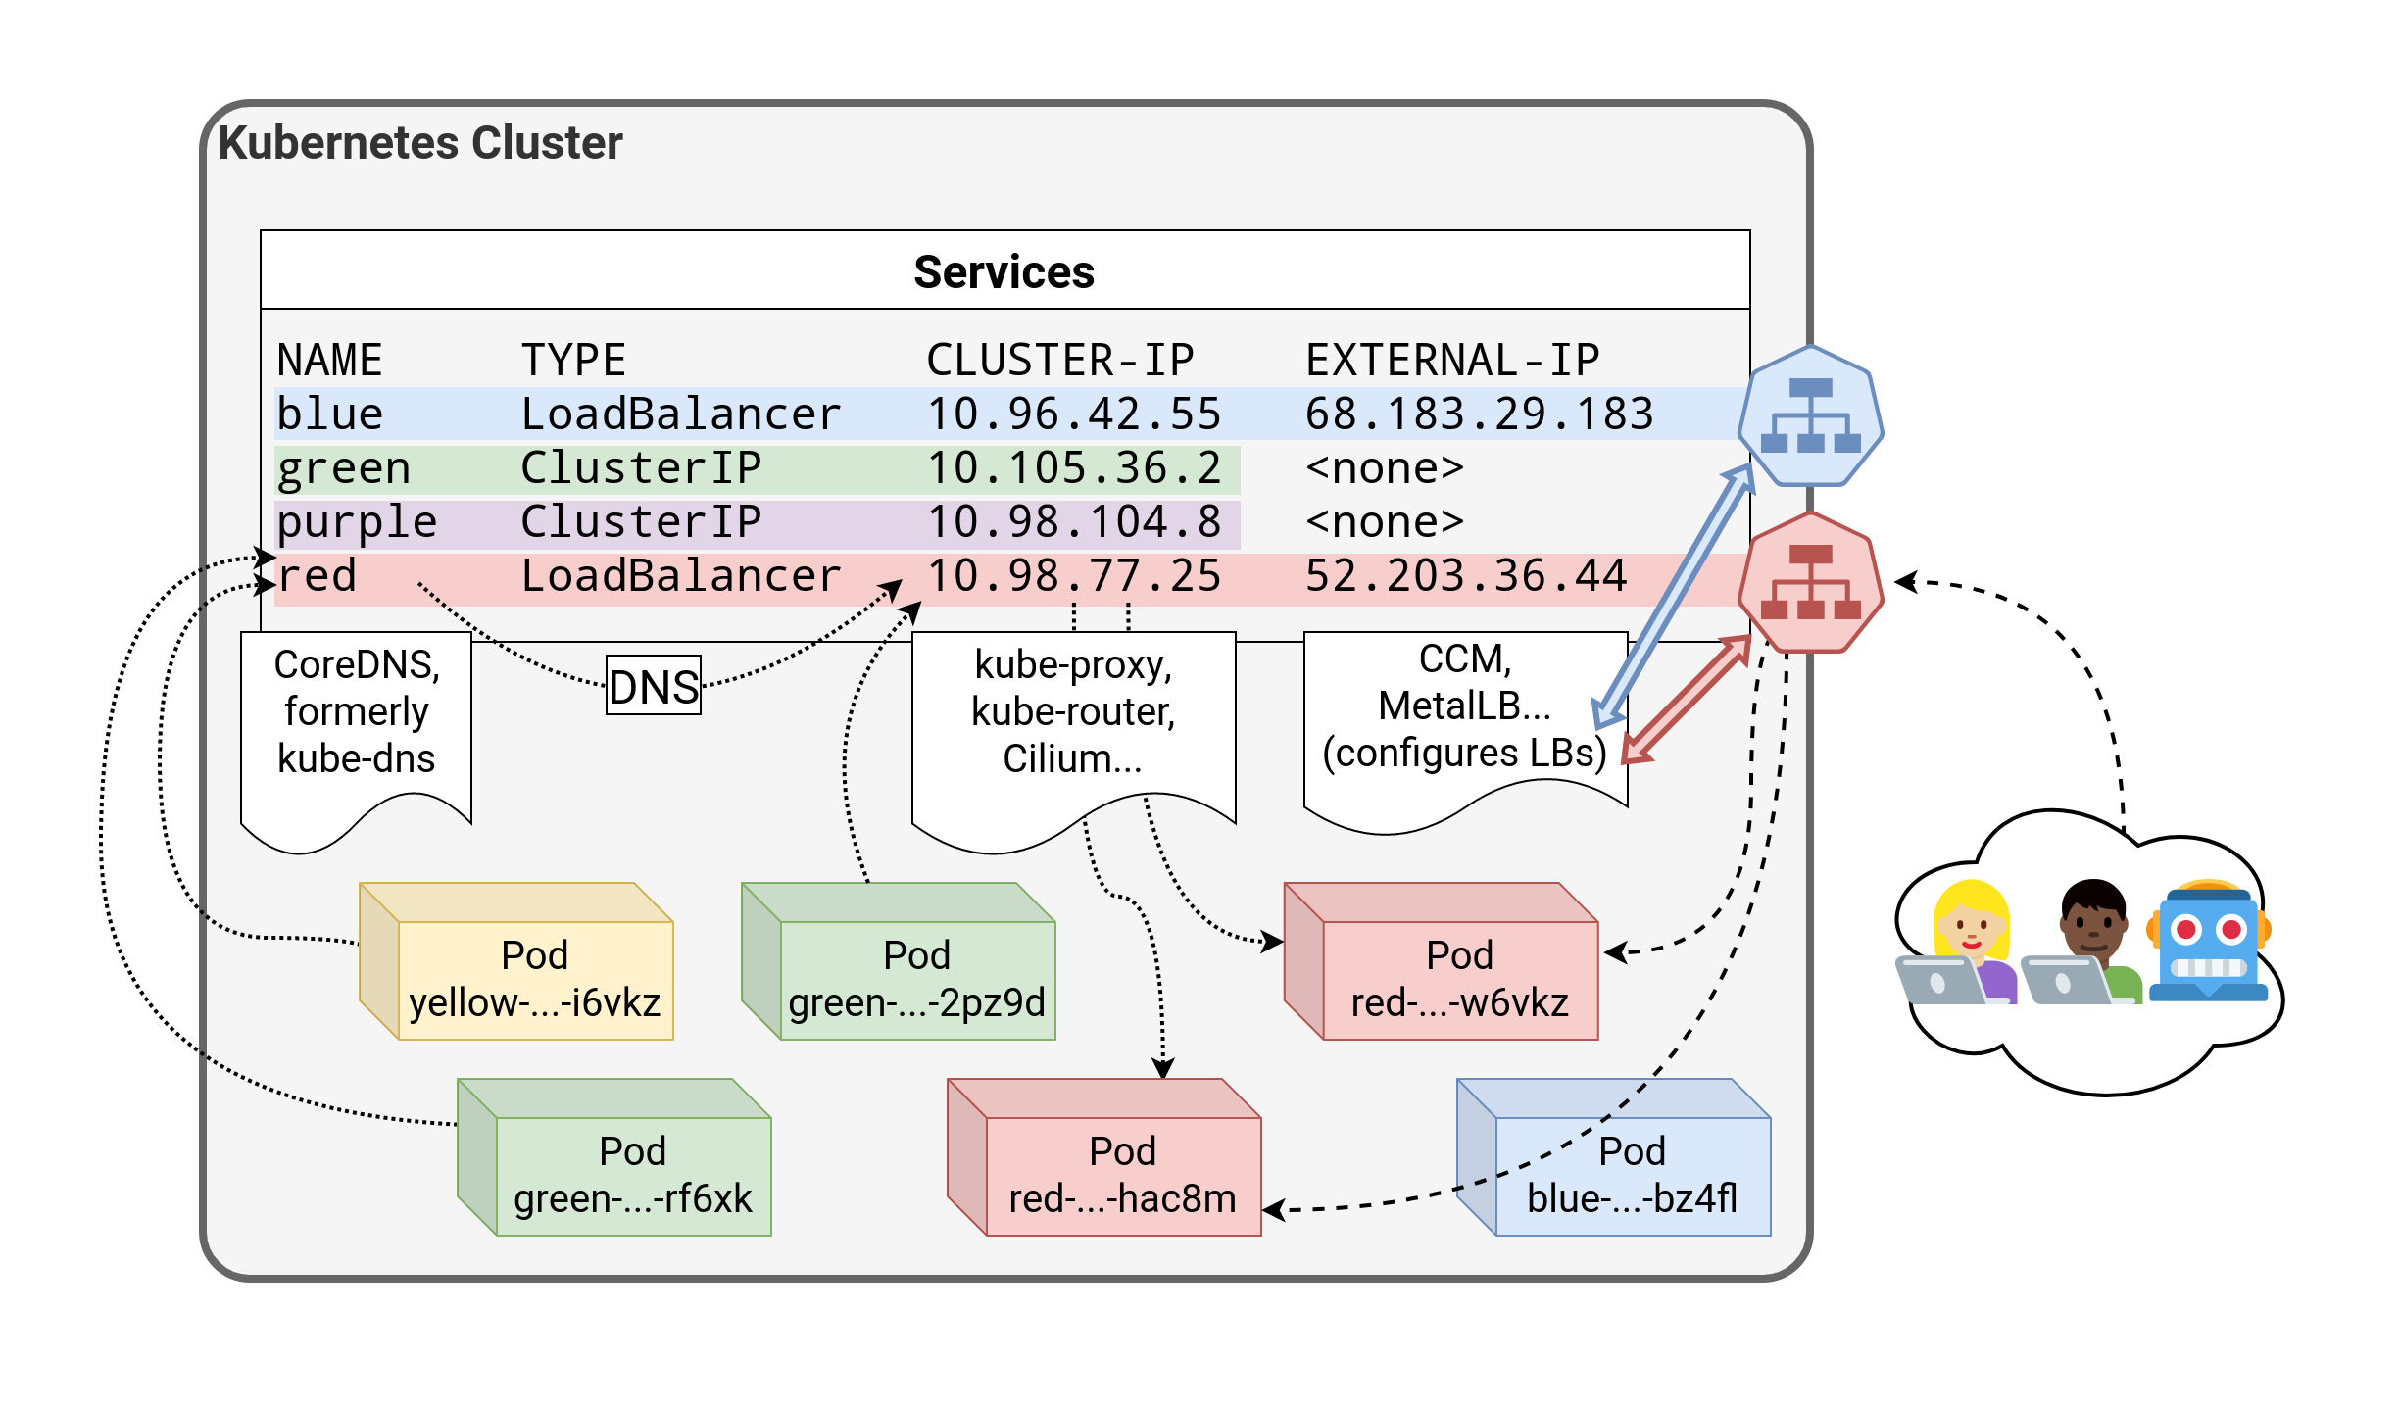

Slide 32
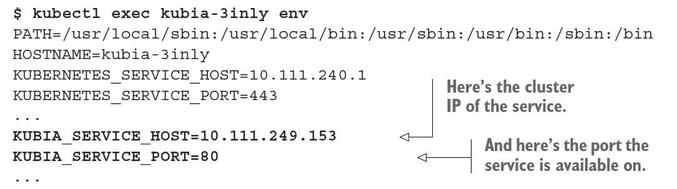
Discovering Services
$ kubectl exec -it kubia-3inly bash
root@kubia-3inly:/#
# Inside the container
root@kubia-3inly:/# curl http://kubia.default.svc.cluster.local
You’ve hit kubia-5asi2
root@kubia-3inly:/# curl http://kubia.default
You’ve hit kubia-3inly
root@kubia-3inly:/# curl http://kubia
You’ve hit kubia-8awf3
root@kubia-3inly:/# cat /etc/resolv.conf
search default.svc.cluster.local svc.cluster.local cluster.local ..
Through Environment Variables
Through DNS servers and FQDNs

Slide 33
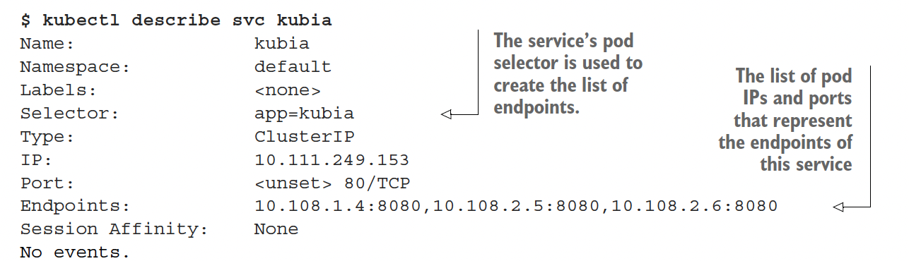
Service Endpoints
An Endpoints resource (yes, plural) is a list of IP addresses and ports exposing a service.
The selector is used to build a list of IPs and ports, which is then stored in the Endpoints resource.
When a client connects to a service, the service proxy selects one of those IP and port pairs and redirects the incoming connection to the server listening at that location.

Slide 34
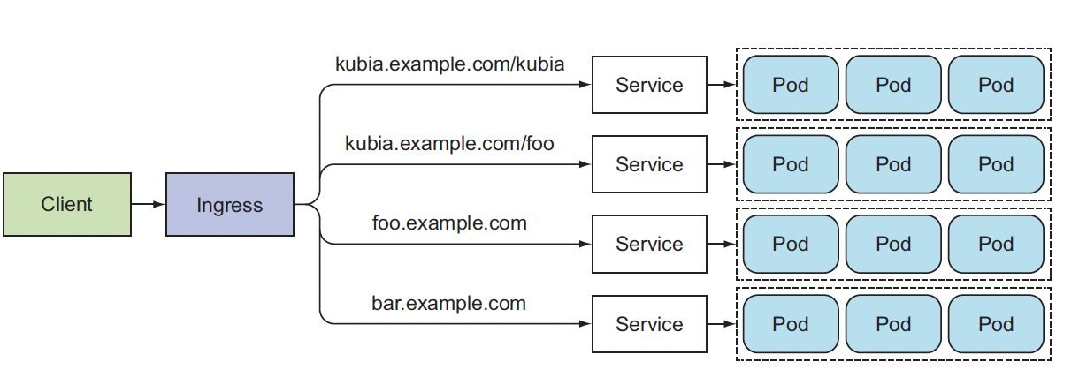
Ingress Resource

Slide 35
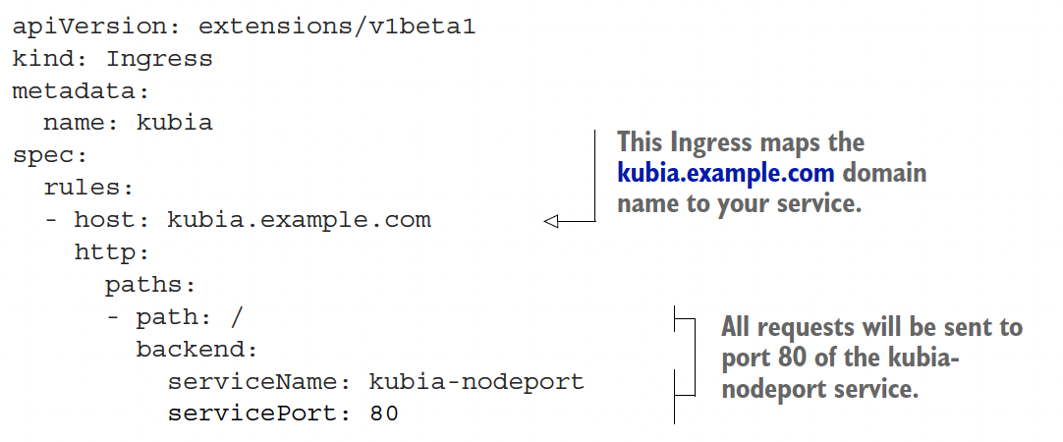
Understanding Ingress
Layer 7 load balancer
Provides cookie-based session affinity
Level 7 routing
Requires ingress controller to be installed in the cluster

Slide 36
Workshop 3 – Using K8s Services

Slide 37
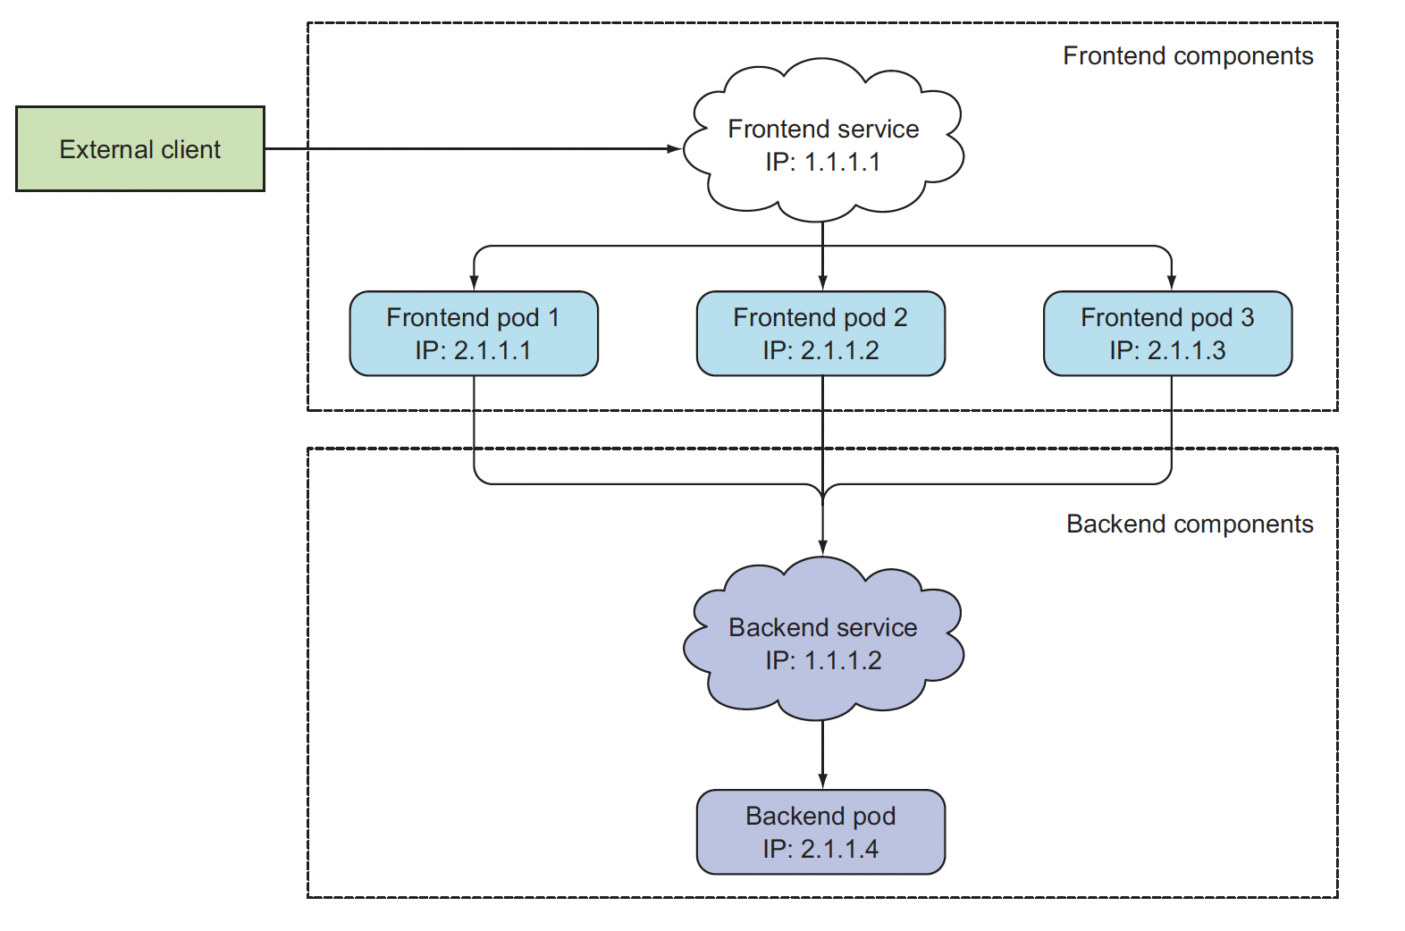
Example: 2-Tier Web application
Notes:
https://docs.vmware.com/en/VMware-Cloud-Foundation/services/vcf-developer-ready-infrastructure-v1/GUID-6F184EC5-AFC1-4D0A-A5D5-1E31EE938438.html

Slide 38
Create the Namespace
# Copy all the deployment files to the EC2 with our kind cluster
scp -i week6 week6Session2/* 100.27.36.251:/tmp/
# log into you EC2
ssh -i week6 [EC2 public IP]
# Verify the cluster is running
k get nodes
# Create a namespace for our Guestbook application
k create ns guestbook

Slide 39
Deploying application components: MongoDB
# Deploy application component – MongoDB
k apply -f /tmp/mongo-deployment.yaml -n guestbook
# Verify the successful deployment
k rollout status deployment.apps/mongo -n guestbook
k describe -n guestbook deployment.apps/mongo
# Create service to expose mongoDB to internal cluster users
k apply -f /tmp/mongo-service.yaml -n guestbook
Explain: what type of service did we create? Why is this the right type of service to use with Mongo DB?
# Verify the service is created
k get svc -n guestbook
# Examine Service Endpoints
K describe service mongo -n guestbook

Slide 40
Deploy Application Components: Frontend
# Create frontend deployment
k apply -f /tmp/frontend-deployment.yaml -n guestbook
# Verify the successful deployment
k rollout status deployment.apps/frontend -n guestbook
k describe -n guestbook deployment.apps/frontend
# Create service to expose mongoDB to internal cluster users
k apply -f /tmp/frontend-service.yaml -n guestbook
# Verify the service is created
k get svc -n guestbook

Slide 41
Connecting to GuestBook Application with ClusterIP
# Our ClusterIP service listens on port 80. We will forward local port 8080 to service port 80 with port-forward
k port-forward svc/frontend 8080:80 -n guestbook
# Verify access to the service from another terminal window
curl localhost:8080
# Open port 8080 in the Security Group and try to access the application via [PublicIP]:8080 in the browser.
# Explain: Was it successful? Why?

Slide 42
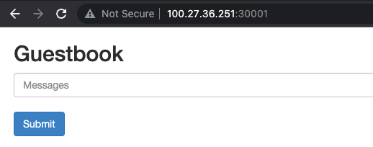
Connecting to GuestBook Application with NodePort
# Update the service type to NodePort
k apply -f /tmp/frontend-serviceNodePort.yaml -n guestbook
# Verify that the port forward is still running, and we can still connect via kubectl port forward
curl localhost:8080
# Open port 30001 in the Security Group and try connection from the browser with [EC2 Public IP]:30001

Slide 43
Connecting to GuestBook Application with NodePort – change the NodePort to 30100
# Try connecting with the different NodePort, e.g. 30100. Update the NodePort in the frontend-serviceNodePort.yaml and update the service
k apply -f /tmp/frontend-serviceNodePort.yaml -n guestbook
# Verify we can still connect with ClusterIP
curl localhost:8080
# Update EC2 Security Group and try connecting to the application from the browser using [EC2 Public IP]:30100
# Exlain: Was it successful? Why?

Slide 44

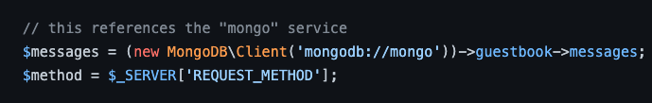
Frontend connection to MongoDB – how does it work?
We will research Pod template
Google paulczar/gb-frontend
Find it on DockeHub
Look at the digest
Look for guestbook.php and mongodb
https://github.com/kevinraymond/php-guestbook/blob/main/app/guestbook.php
The answer
Explain: Would our application work if we give our MongoDB service a different name?

Slide 45
Changing MongoDB Service Name
# Delete the mongo service and frontend deployment and service
k delete svc frontend -n guestbook
k delete deployment frontend -n guestbook
k delete svc mongo -n guestbook
# Update the /tmp/mongo-service.yaml and rename the service
# Apply the changes
k apply -f /tmp/mongo-service.yaml -n guestbook
k apply /tmp/frontend-deployment.yaml
k apply -f /tmp/frontend-service.yaml -n guestbook
# Verify we can still connect with ClusterIP
curl localhost:8080
-bash-4.2$ curl localhost:8080
curl: (7) Failed to connect to localhost port 8080 after 0 ms: Connection refused

Slide 46
Workshop 3 – The End

Slide 47
Workshop 4 – DNS in K8s

Slide 48
Creating a deployment for our HTTP server
# Create a deployment for this very lightweight HTTP server:
k create deployment blue --image=jpetazzo/color
# Scale it to 10 replicas:
k scale deployment blue --replicas=10
# Pods are created
k get pods -l app=blue

Slide 49
Exposing our deployment – Create ClusterIP service
# Expose the HTTP port of our server
k expose deployment blue --port=80
# Look up which IP address was allocated
k get svc
k get svc blue -o yaml

Slide 50
Test the Access to the Application
# Test the service from inside the K8s "node" that runs as a container in our environment
docker exec -it [CONTAINER ID] /bin/bash
# Send curl request to ClusterIP from the bash prompt of the container that simulates our master node. Try it a few times! Our requests are load balanced across multiple pods.
curl [ClusterIp of blue service]
# Result
root@kind-control-plane:/# curl 10.96.136.226
🔵This is pod default/blue-796f87cc56-9dmrx on linux/amd64, serving / for 10.244.0.1:44398.

Slide 51
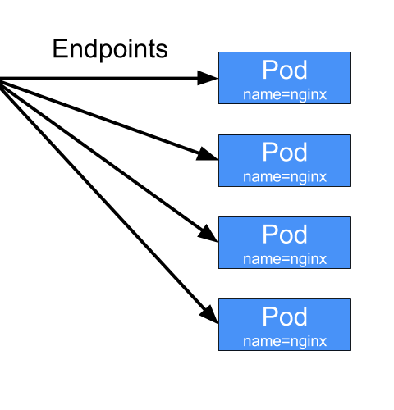
Services and endpoints
A service has a number of "endpoints"
Each endpoint is a host + port where the service is available
The endpoints are maintained and updated automatically by Kubernetes
# Get service Endpoints
k describe service blue
k get endpoints
k describe endpoints blue
k get endpoints blue -o yaml
# Compare to the output below
k get pods -l app=blue -o wide

Slide 52
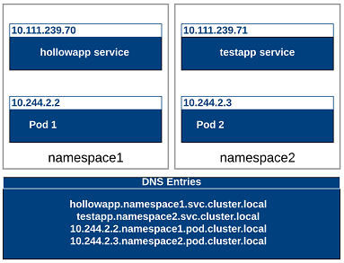
DNS in K8s
In the kube-system namespace, there should be a service named kube-dns
This is the internal DNS server that can resolve service names
The default domain name for the service we created is default.svc.cluster.local

Slide 53
Examine DNS in the pod
# log into blue pod
k exec -it blue-796f87cc56-7tbfc -- /bin/sh
# Examine the nameservers defined in the pod.
# What is running on IP is 10.96.0.10?
# What are the entries in the resolv.conf file?
cat /etc/resolv.conf
search default.svc.cluster.local svc.cluster.local cluster.local ec2.internal
nameserver 10.96.0.10
options ndots:5

Slide 54
Workshop 4 – The End

Slide 55

Additional Resources
https://kubernetes.io/docs/concepts/services-networking/service/
https://medium.com/devops-mojo/kubernetes-service-types-overview-introduction-to-k8s-service-types-what-are-types-of-kubernetes-services-ea6db72c3f8c
https://docs.vmware.com/en/VMware-Cloud-Foundation/services/vcf-developer-ready-infrastructure-v1/GUID-6F184EC5-AFC1-4D0A-A5D5-1E31EE938438.html
https://container.training/kube-selfpaced.yml.html#273
https://www.bookstack.cn/read/kubernetes-1.21-en/59a313e057e11c1b.md
https://arthurchiao.art/blog/cracking-k8s-node-proxy/
https://iximiuz.com/en/posts/service-discovery-in-kubernetes/

